Slide 1
ACIDS & BASES

Slide 2
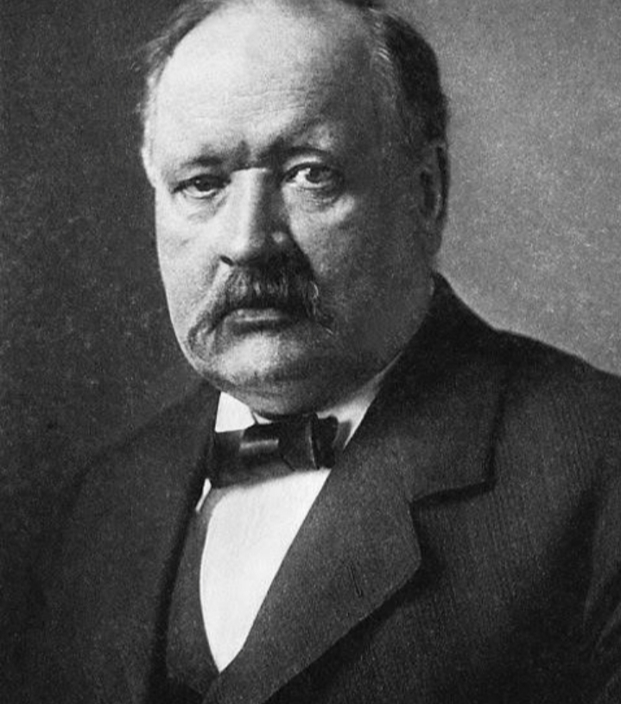
ACIDS & BASES
Three major definitions of acids and bases have influenced the thinking of chemists. In 1884, Svante Arrhenius formulated the first of these definitions. Then, in 1923, independently of each other, Johannes N. Brønsted and Thomas M. Lowry developed the second. The third definition grew from Gilbert Newton Lewis’s theory of covalent bonding, which he proposed in 1916.
The Arrhenius acid-base theory provided a good start toward understanding acid-base chemistry.
An Arrhenius acid is a source of H⊕ ion.
An Arrhenius base is a source of -OH ion.
An acid is a substance that, when added to water, increases the concentration of hydronium ions, H3O⊕. Because Arrhenius regarded acid-base reactions as occurring only in water, he frequently called the hydronium ion a hydrogen ion, H⊕. An H⊕ ion is a proton, or a hydrogen that is electron-deficient. Thus, a base is a substance that, when added to water, increases the concentration of hydroxide ions, c- OH.

Slide 3
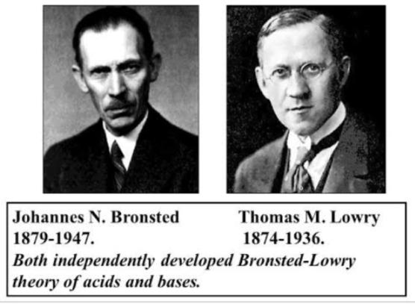
Bronsted-lowry Concept of acids & bases
Brønsted and Lowry developed a more general acid-base definition than that of Arrhenius. Although they considered reactions other than those that take place in aqueous solutions, they still said acids were molecules that donate a hydrogen ion—such as HCl and H2SO4. However, they broadened the definition of bases to include any compound that accepts a proton. The basis of their acid-base definition is that in a reaction a proton transfers between reactants. Thus, acids involving a transfer of H⊕ ions are sometimes called proton acids. According to the Brønsted-Lowry definition, an acid is any molecule or ion that donates a proton to another molecule or ion, and a base is any molecule or ion that receives that proton. The following statements briefly summarize the.
A Brønsted-Lowry acid is a proton donor.
A Brønsted-Lowry base is a proton acceptor.

Slide 4
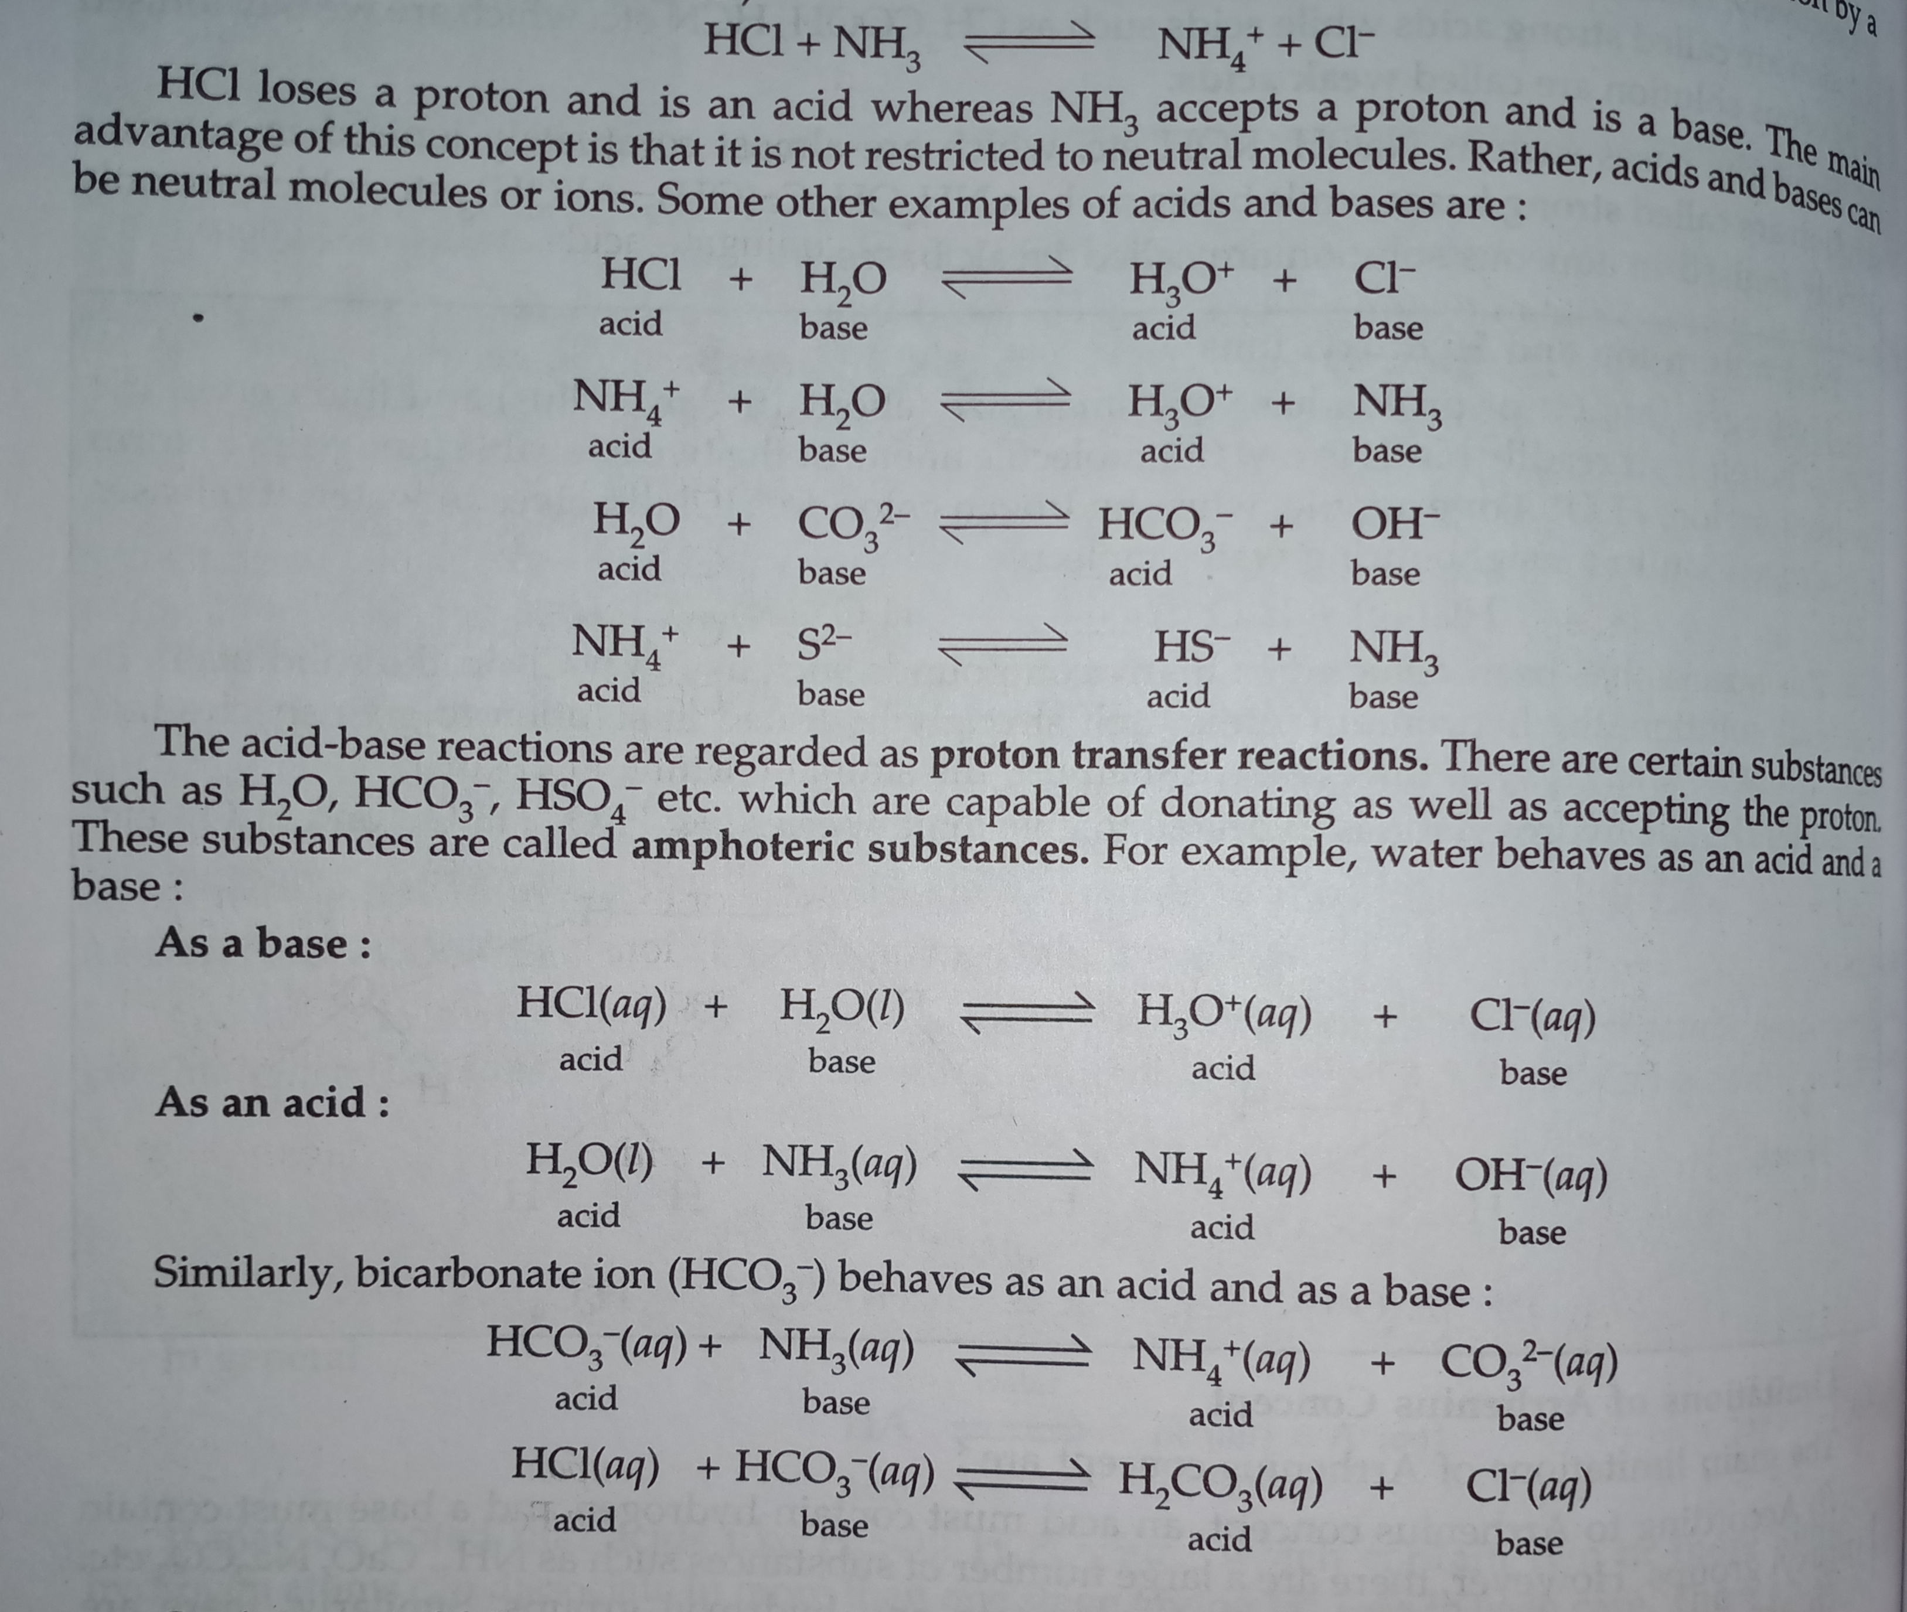
An example of the Brønsted-Lowry definition is

Slide 5
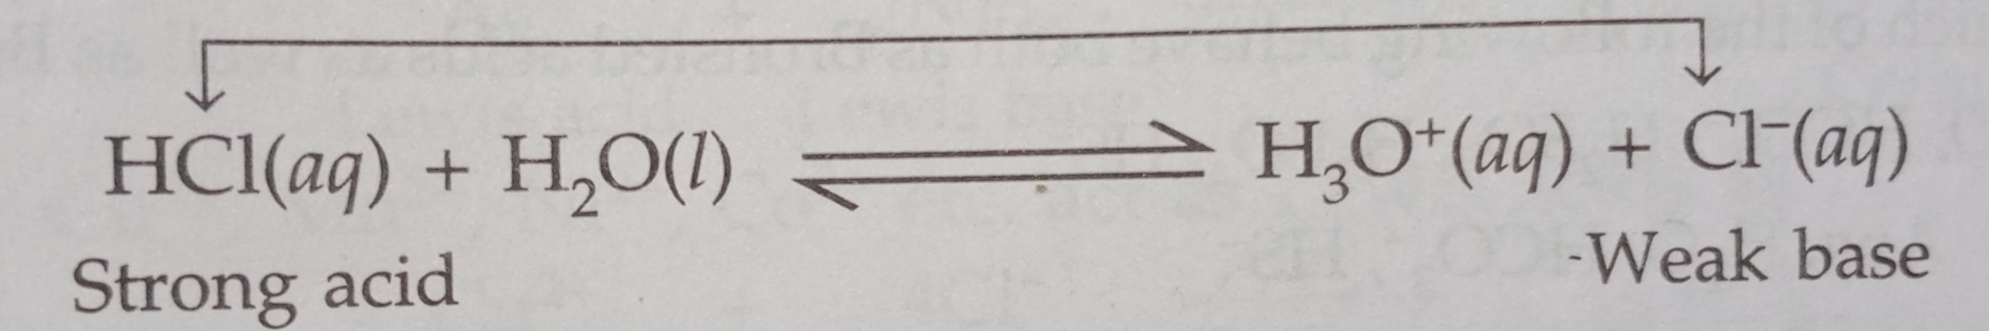
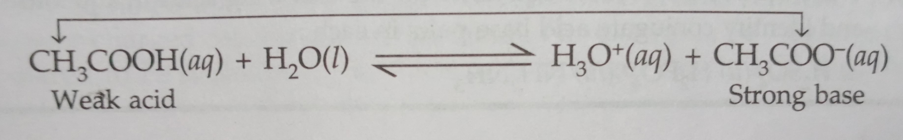
Relative strength of Conjugate acids & bases
According to bronsted-lowry concept, the strength of an acid depends upon its tendency to donate a proton and the strength of a base depends upon its tendency to accept a proton.
For example, consider the dissociation of HCl in water,
HCl has a strong tendency to donate a proton, therefore, Cl- ion is a weak base. Thus, the equilibrium lies towards right hand side. Thus, conjugate base of a strong acid is a weak base. Consider the dissociation of acetic acid.
Now, Acetic acid is a weak acid and the equilibrium lies towards left. This also indicates that CH3COO- ion has greater tendency to accept the Proton and therefore, is a strong base.

Slide 6
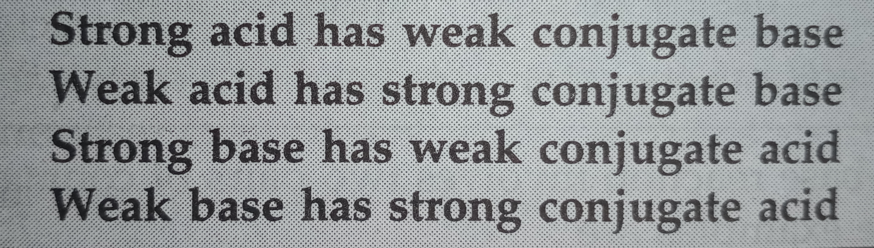

Slide 7
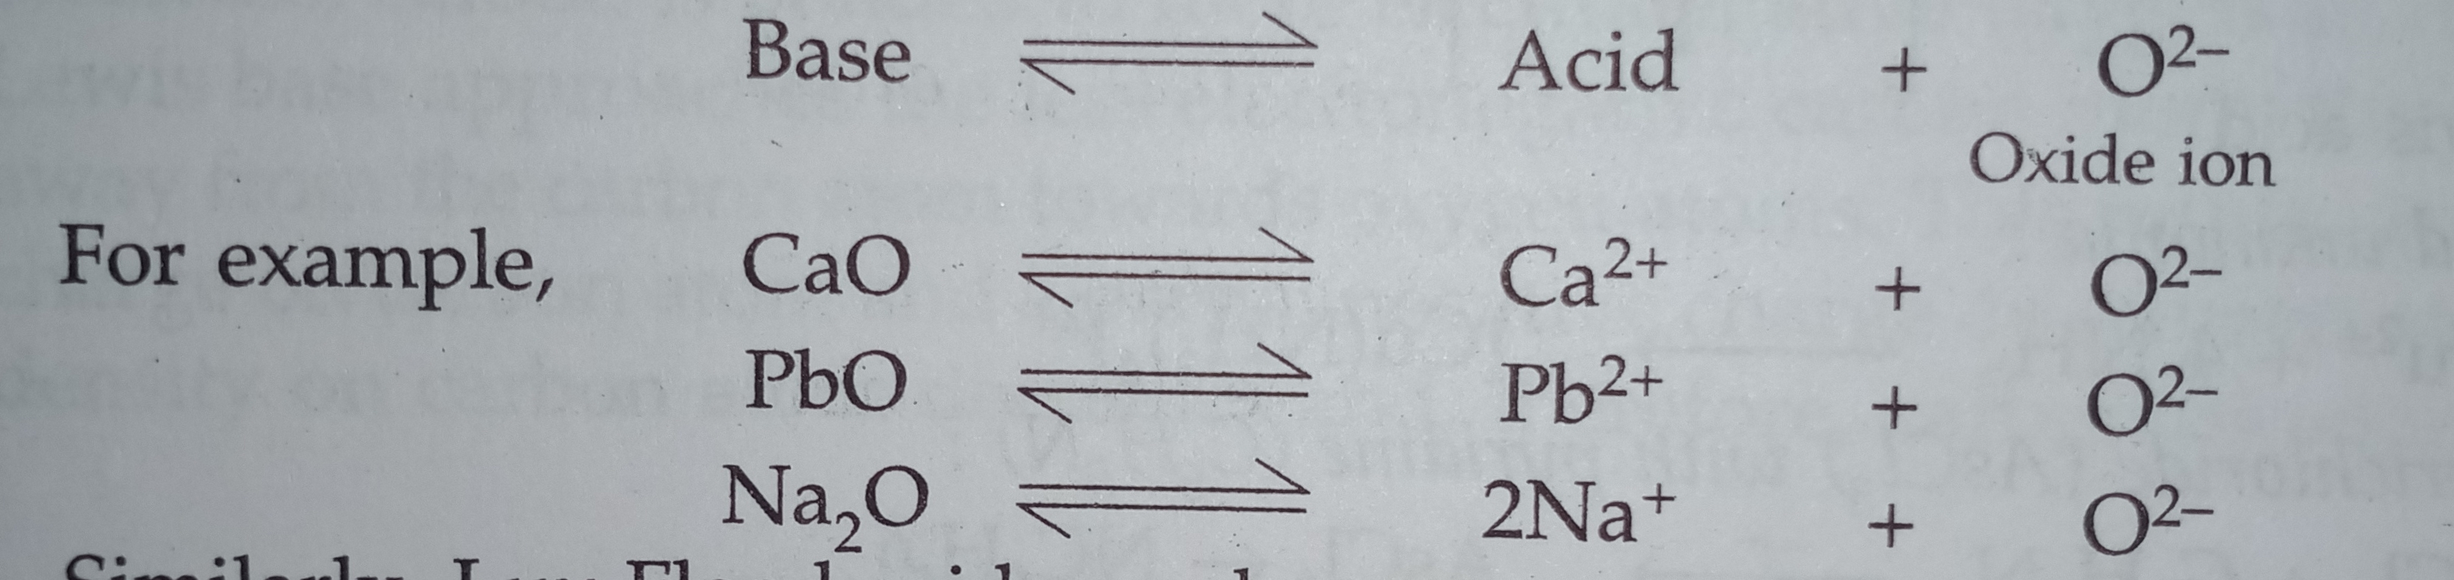
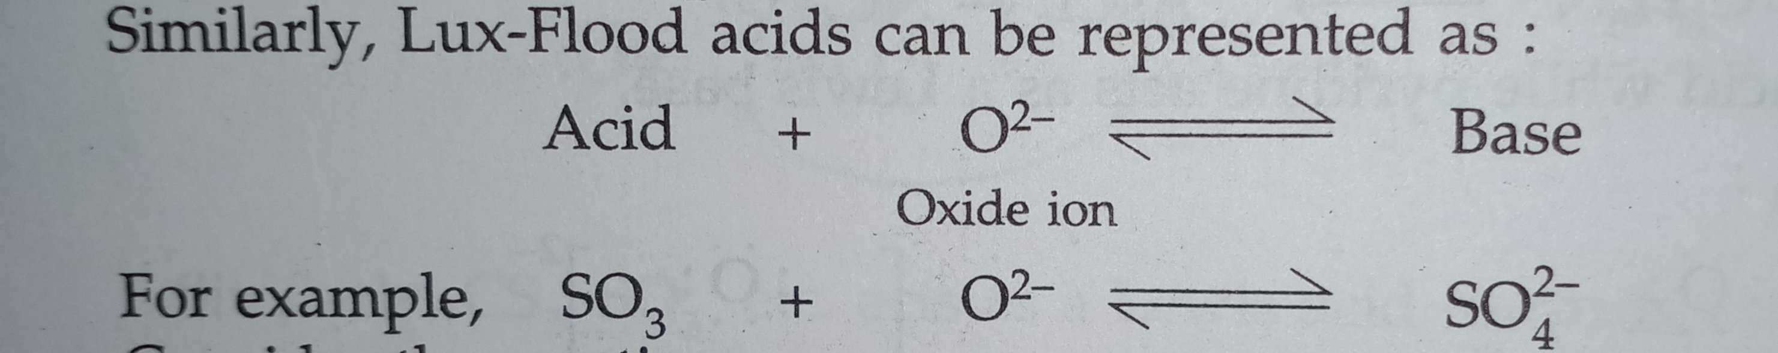
Lux flood concept of acid & bases
According to Lux flood concept,
An acid is a substance which accepts oxide ion and
A base is a substance which donate the oxide ion.
In other words, an acid is an oxide- acceptor and a base is an oxide- donor.
Thus, Lux flood bases can be represented as:
Similarly, LUX FLOOD acids can be represented as:

Slide 8
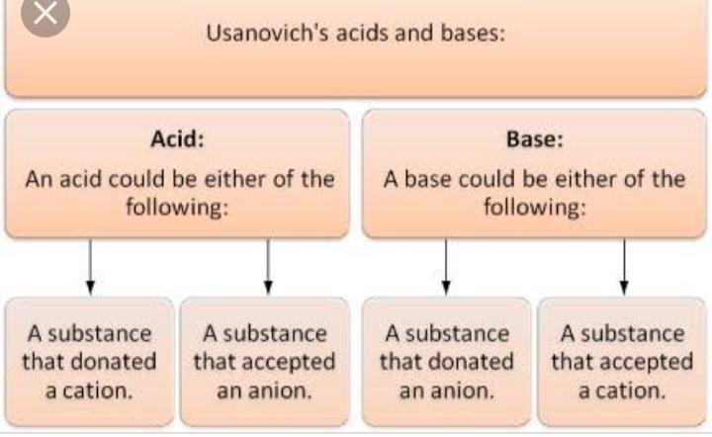
Usanovich concept of acid & bases
An acid is a substance that reacts with bases Forming salts, gives up cations or accept anions or electrons.
A base is a substance that reacts with acids, gives up anions or electrons or combines with cations.

Slide 9
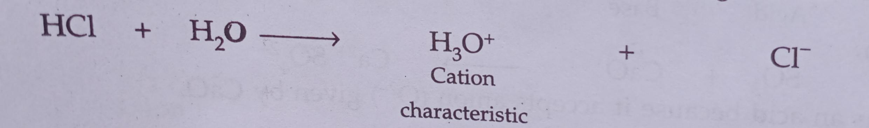
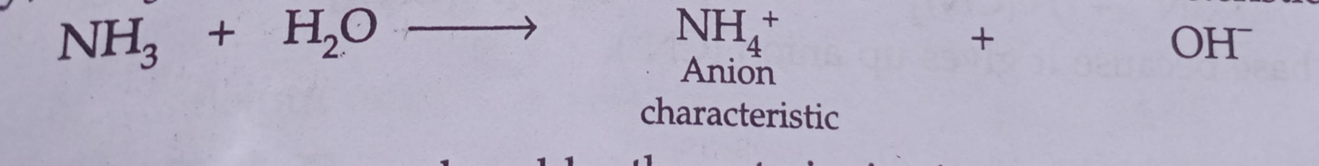
Solvent system concept (cady elsey’s concept)
According to solvent system concept,
An acid is a substance which either by direct dissociation or by reaction with the solvent gives the cation characteristics of the solvent.
A base is a substance which either by direct dissociation or by reaction with the solvent gives the anion characteristics of the solvent.

Slide 10
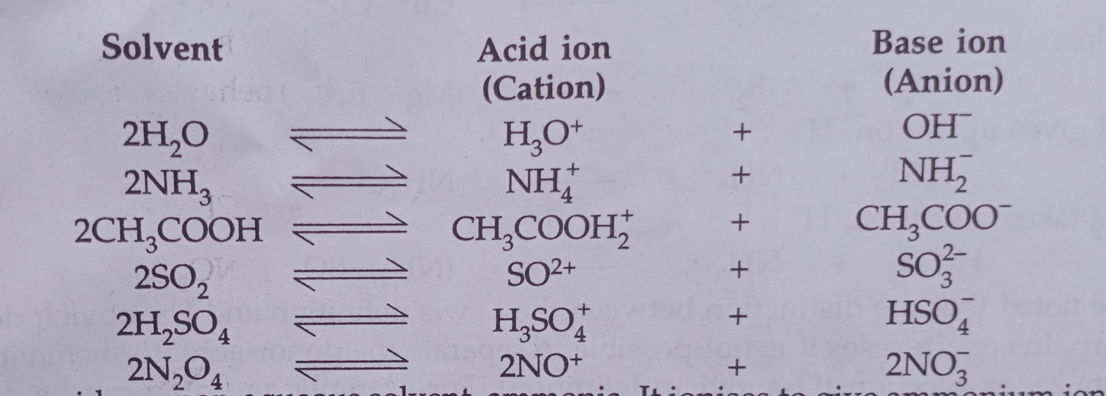
The cations and anions produced by the auto-ionization of some protonic and non-protonic acids are:

Slide 11
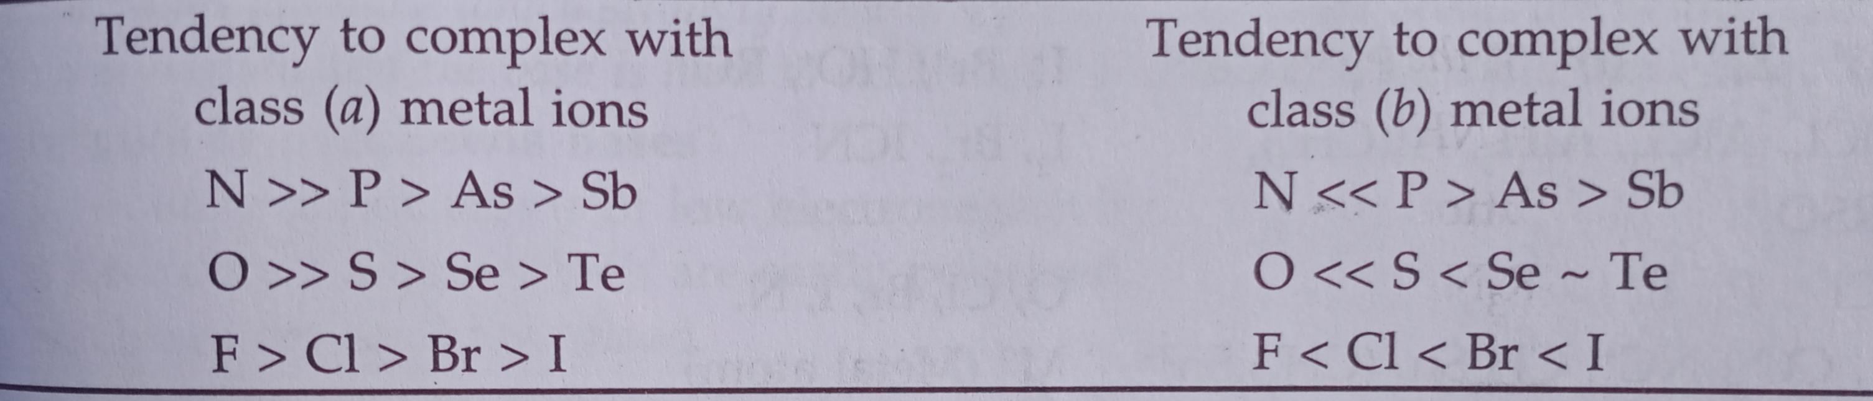
Hard & soft acids & bases
Class A metal ions include those of alkali metals, alkaline earth metals and lighter Transition metals in their higher oxidation states such as Ti4+, Cr3+, Fe3+, Co3+, etc. And the hydrogen ion, H+.
Class B metal ions include those of heavier transition metals (of second and third transition series such as Hg2+, Pd2+, Pt2+, Cd2+) and those in lower oxidation states (such as Cu+, Ag+, Hg+, etc).
Class A ligands include those molecules or ions which have the donor atoms N, O, F, Cl, etc. These ligands combine preferably with type (a) metal ions.
Class B ligands include those molecules or ions which have the donor atoms P, As, S, Se, I, etc. These ligands combine preferably with type (b) metal ions.
The stability of these complexes may be summarised as:

Slide 12
Characteristics of hard acids
Hard acids are cations with small size.
They are cations with higher oxidation state.
They do not posses large number of valence electrons, hence they are not easily polarize.
CHARACTERISTICS OF SOFT BASES
THE SOFT ACIDS HAVE CATIONS OF LARGE SIZE.
THE CATIONS HAVE USUALLY ZERO OR LOW OXIDATION STATES.
THE SOFT ACIDS HAVE LARGE NUMBER OF VALENCE ELECTRONS & THEREFORE, THEIR OUTER ELECTRONS WILL BE EASILY REMIVED OR DISTORTED.

Slide 13
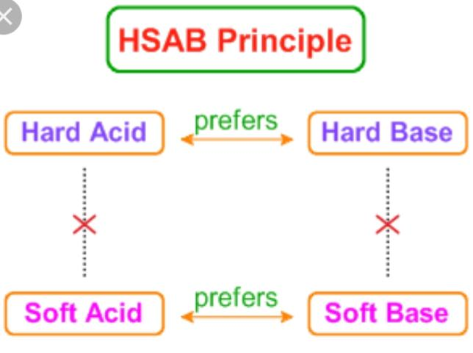
Pearson’s hsab principle
Pearson has proposed a simple rule for predicting the stability of compounds formed from acids and bases. This is known as HSAB principle. It states that,
Hard acids prefer to bond to hard bases and soft acids prefer to bond to soft bases.

Slide 14
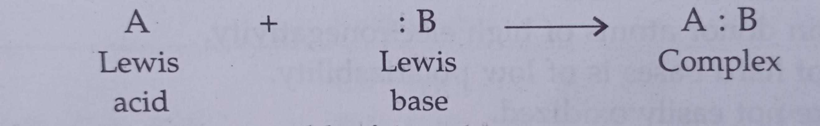
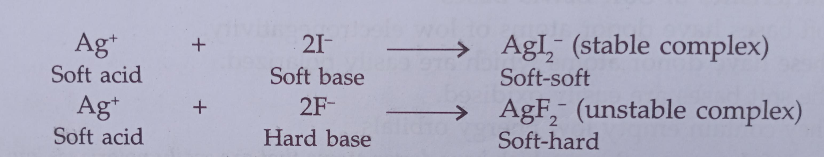
Applications of HSAB principle
Stability of complexes:

Slide 15
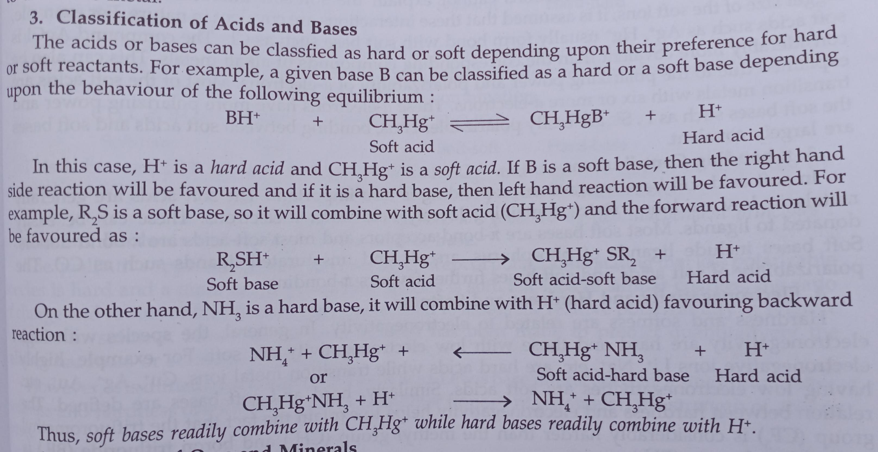
1. Prediction of coordination in complexes of ambidentate ligands.
3.Classification of acids and bases.
4. Occurrence of ores and minerals.
5. Poisoning of metal catalyst.

Slide 16
Limitations of HSAB PRINCIPLE
This principle is general and does not provide any quantitative scale of measurement.
The hard-soft factors are independent of acidiic or basic character of compounds. These factors work independently.

Slide 17
…..Thank you 🤗

